Slide 1
Snowflake Training Day 1

Slide 2
Agenda
Cloud Service Models
Cloud Data Warehousing
Introduction to Snowflake
Catalog and Object
Data Loading & Unloading
LAB
UI Walk through
Stage & Warehouse Creation
Data load & unloading
Day 1

Slide 3





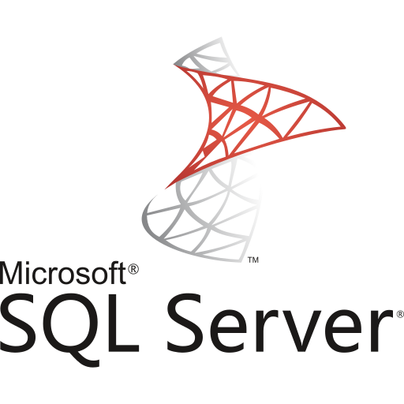
CLOUD SERVICES MODELS
IaaS | PaaS | SaaS
Subscription based access to physical / virtual infrastructure | Subscription based access to ready-to-use platform for development. | Subscription Based Service to use software over the internet
Goal is to do away from managing the Data Center but still want more control over database software, OS and other configurations. | Goal is to rent hardware and software components from a cloud provider | Goal is to abstract all the details – including data center and the software and hardware platform
Notes:
Add more talking points on cloud platform.

Slide 4
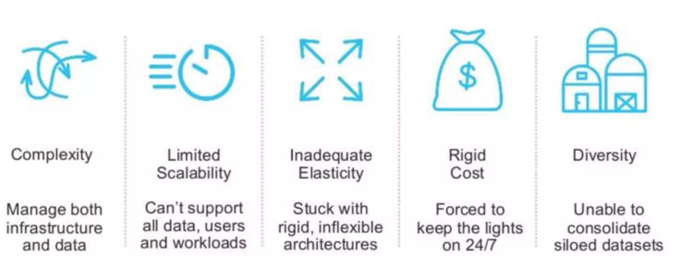
LEGACY DW - CHALLENGES
Notes:
Scalability has become the most desirable thing for any data team.

Slide 5
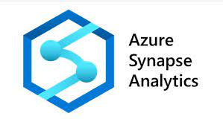
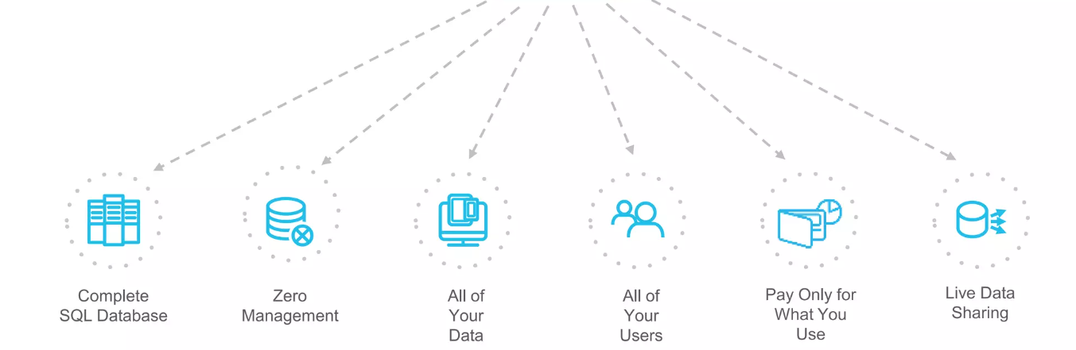


CLOUD DW - BENEFITS

Slide 6
How snowflake is different
KEY DRIVERS
Cloud & Data Warehouse Native
Independent Compute Clusters
It’s SQL
Low to No Management Overhead
Consumption-Based
All Data & Data Sharing
Multi-Cloud — AWS, Azure, and GCP
Single place for data
Scale & concurrency
Zero management
Instant, live data sharing
Unique architecture: Multi-cluster, shared data

Slide 7
All of your data
IoT
Structured and semi-structured data (JSON, XML, Avro)
Centralized storage of data, accessible by any user and application
Multi-petabyte scale
Web
Enterprise apps
3rd party apps
Corporate
Mobile

Slide 8
All of your users
Up to 200x faster than solutions not built for the cloud
Maintains a consistent SLA – resources grow and shrink automatically
Loading data does not impact query performance
Multiple groups access data at the same time with no performance degradation
Supports an unlimited number of simultaneous users
Predictive analytics
Data exploration
Data-driven applications
BI/Reporting
Diverse applications

Slide 9
Snowflake’s Multi-cluster, shared data architecture
Transactions
Security
Management
Ad hoc analytics
Service
Compute
Centralized storage
Storage
Development
Loading
Metadata
Optimization
Instant, automatic scalability & elasticity
Notes:
Talk about the scalability of a Hadoop environment.

Slide 10
But snowflake is NOT ENTIRELY DIFFERENT
A complete SQL DB and is ANSI SQL
ACID complaint
Support for all traditional datatypes like CLOB, BLOB, etc
Most of the DB objects are supported
Like most of the MMP systems like Netezza, Teradata etc
Columnar storage, designed to serve DW needs

Slide 11
Real-World use case
Interactive Dashboard
50% < 1s 85% < 2s 95% < 5s
Continuous Loading (4TB/day)
S3
<5min SLA
Virtual Warehouse
Auto Scale – X-Large x 5
Virtual Warehouse
Medium
Reporting (Segmented)
ETL & Maintenance
Prod DB
Virtual Warehouse
2X-Large
Virtual Warehouse
Large
4 trillion rows 3+ petabyte raw data
8x compression ratio
25M micro partitions

Slide 12
Snowflake edition
Feature/Service | Standard | Enterprise | Business Critical | Virtual Private Snowflake
24-Hour access to new releases |  | ✓ | ✓ | ✓
Customer managed encryption Keys |  | ✓ | ✓ | ✓
Row Level, Column Level Security |  | ✓ | ✓ | ✓
Fail Safe/Time Travel | 7days/1day | 7days/90days | 7days/90days | 7days/90days
Multi Cluster Warehouse |  | ✓ | ✓ | ✓
Materialized View |  | ✓ | ✓ | ✓
Data Sharing | ✓ | ✓ | ✓

Slide 13
UI WALKTHROUGH
Notes:
Trial Account Creation
Walkthrough of UI
Virtual warehouse Link
Catalog & Objects
Data Loading (file format, type of stages, structured data BULK LOAD)
Sequence
transform during load (structured data)
Data unloading (bulk unload)
querying, accessing, transforming and loading semi structured data
8.CTE (common table expression)
Provide necessary links and documents

Slide 14
VIRTUAL WAREHOUSE
Warehouse = cluster of cloud instances called worker nodes.
Pure Compute Resources
Created, Resized, Destroyed on demand
Multiple warehouses can be run at a time
Each warehouse has access to all the data but isolated performance
All warehouses can be shut down in case of no activity
Clusters can be resized horizontally as well as vertically.

Slide 15
CATALOGS & OBJECTS
Table Types
Temporary, Transient, External & Permanent
Table Design Consideration
Do not define columns to contain dates or timestamps as VARCHAR
Referential integrity constraints in Snowflake are informational and are not enforced.
NOT NULL constraints are only enforced
Specifying a clustering key for majority of the tables are not required.
Creating columns larger than necessary has no impact on the size of data tables.
Store Semi-structured Data in a VARIANT Column
Type | Persistence | TT Retention Period | Fail-safe Period
Temporary | Remainder of session | 0 or 1 (default is 1) | 0
Transient | Until explicitly dropped | 0 or 1 (default is 1) | 0
Permanent (Standard Edition) | Until explicitly dropped | 0 or 1 (default is 1) | 7
Permanent (Enterprise Edition and higher) | Until explicitly dropped | 0 to 90 (default is configurable) | 7
View Types
Materialized, view, secured view, recursive view
Notes:
select get_ddl('table', 'mydb.public.salesorders’);
Temporary tables only exist within the session in which they were created and persist only for the remainder of the session.
This means you can create temporary and non-temporary tables with the same name within the same schema.
If the Time Travel retention period for a permanent table is set to 0, it will immediately enter the Fail-safe period when it is dropped.
Transient and temporary tables have no Fail-safe period.
Materialized views are automatically and transparently maintained by SnowflakeFor non-materialized views, the IS_SECURE column in the Information Schema and Account Usage views identifies whether a view is secure.
Snowflake does not allow standard DML (e.g. INSERT, UPDATE, DELETE) on materialized views. Snowflake does not allow users to truncate materialized views.

Slide 16
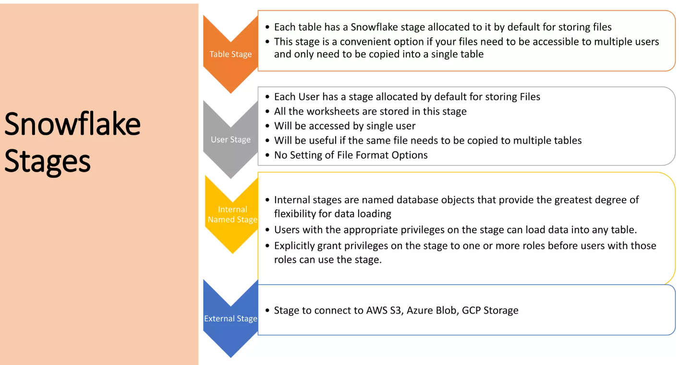
Stages

Slide 17
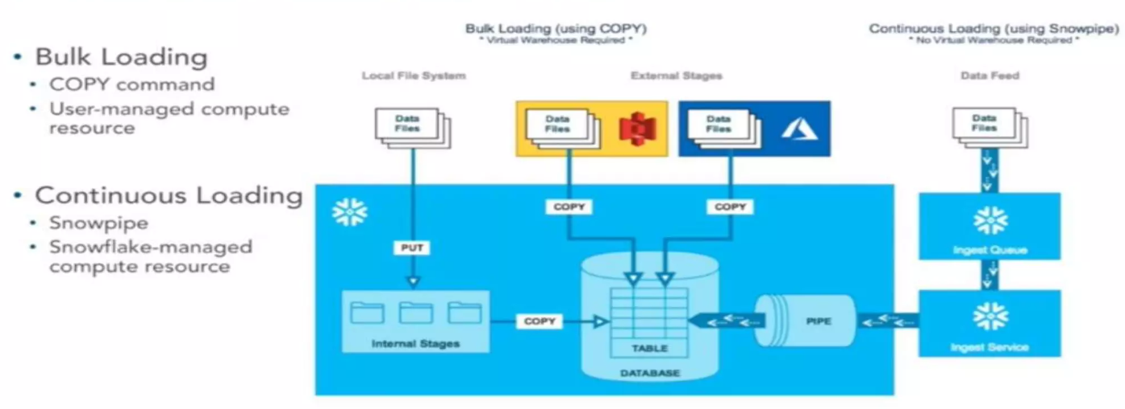
Data LOAD

Slide 18
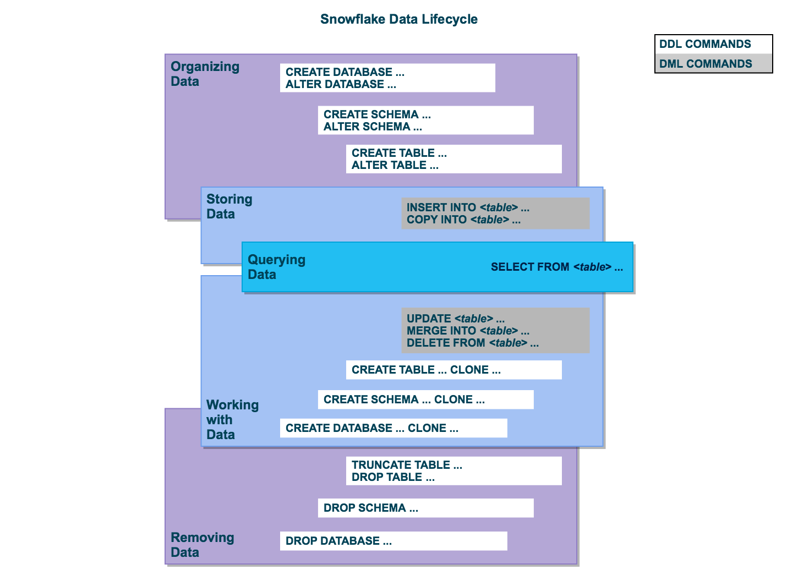
Data lifecycle

Slide 19
Thank You

